Slide 1
BookShare

Slide 2
GROUP MEMBERS
KARTHIK PILLAI
SATYAM YADAV
MOHIT SAINI

Slide 3
Introduction
The Website is being designed to help students connect to each other and sell their books.

Slide 4
Abstract
These project aims at creating an online book sharing website.
The user can register and log on to system.
The user can check the availability of books.
The user can avail books at better and effective price.

Slide 5
Requirements
Software Constraints
Operating System : Windows / Linux
Browser used : Google Chrome , Internet Explorer
Hardware Constraints
Processor : Intel Pentium
RAM : 1GB RAM
Hard Disk : 250 GB
LCD Monitor

Slide 6
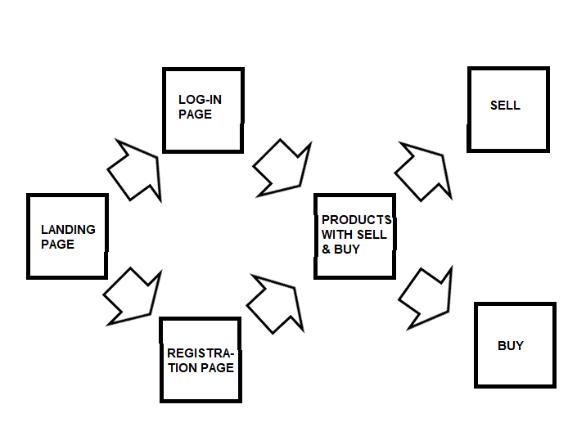
Website Layout

Slide 7
Working of the Website
USER DATA STORED (REGISTRATION)
DATA FROM DATABASE DISPLAYED
USER INSERTS DATA TO THE DB WHILE SELLING
WHILE BUYING USER CAN SEE THE DETAILS OF THE SELLER LIKE NAME, ADDRESS, PHONE NUMBER.
WHATSAPP API

Slide 8

THANK YOU

